Slide 1
Brooklyn Housing Market
An data science exploratory study….
Presented by:
Suhaib Kiani
Steve Li
Yanelly Nunez
Jared Madris

Slide 2
Motivation & Summary
Core Focus
Analyze historical property sales data
Determine variables affecting historical property sales
Questions Asked & Why
What variables have the most significance?
Which variable are correlated with each other?
How can this data be effectively utilized?
Can we run a multi-factor linear regression model on this data?
Summary of Findings
Key determinants of the price of Brooklyn one family houses are area (covered square footage & lot area) and location (school district, neighborhood and zip code)
School district scores based on neighborhood affordability and individual school rankings..
The Brooklyn Dataset can effectively be used for housing price predictive analysis using Linear Regression and/or other methods.

Slide 3
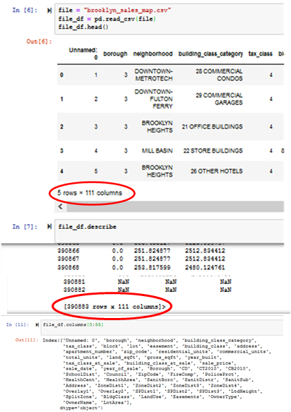
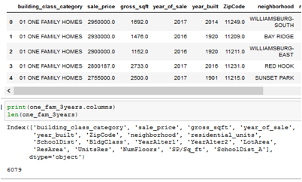
Data Exploration
Orignal Dataset
Data Source: Kaggle, NYC Department of Finance. Source File : CSV.
Details: Brooklyn commercial and residential property sales with various attributes of properties sold
Years of data: 2003 to 2017
Size: 390,883 rows x 111 columns
Filtered Dataset
Key Filters applied:
- Sales Price): $100k - $3 mlm
- Gross sq.ft: Under 3,000 sq.ft
- Brooklyn one family homes sales only
- 17 selected attributes
- Years: 2015 to 2017
Size: 6079 rows x 17 columns
ORIGINAL DATASET
FILTERED DATA

Slide 4
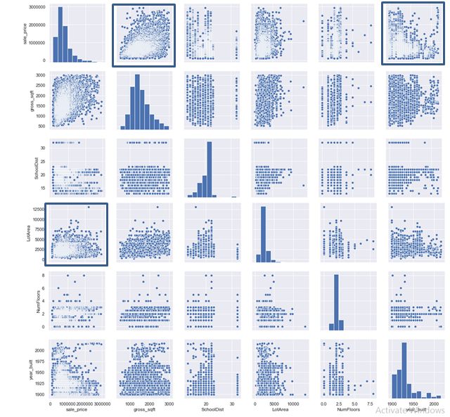
Data Exploration
The Search for Correlation:
Selected Variables
Continuous variables:
Sale Price
Square Footage
Lot Area
Discrete variables:
Number of Floors
Year Built
Year Altered (not shown)
Categorical variables
School District
Neighbourhood (not shown)
ZipCode (not shown)

Slide 5
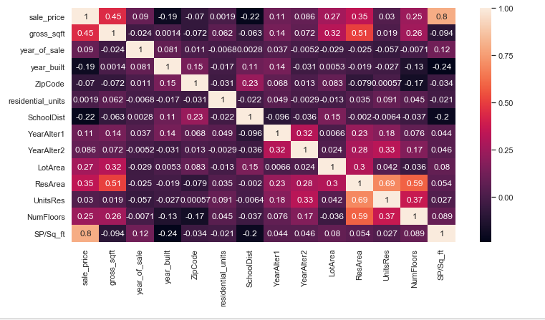
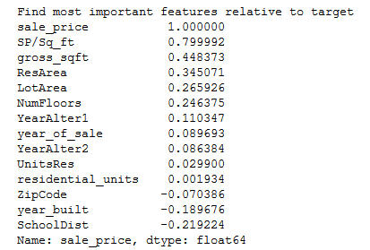
Data Exploration
The Search for Correlation (continued)...

Slide 6
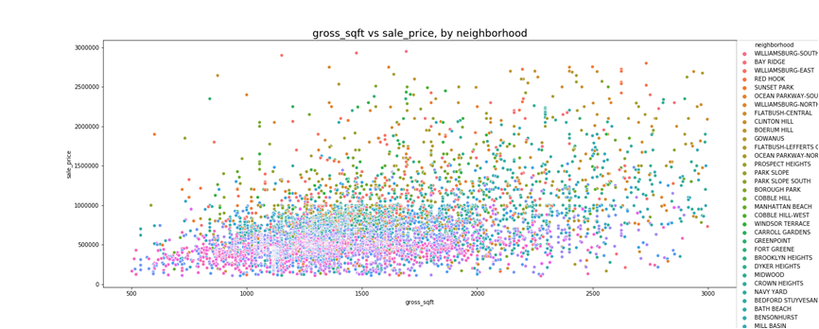
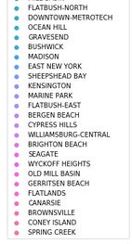
Data Exploration
Sale Price shows a direct relationship with Square Footage… with ‘Neighbourhood’ influence also apparent.

Slide 7
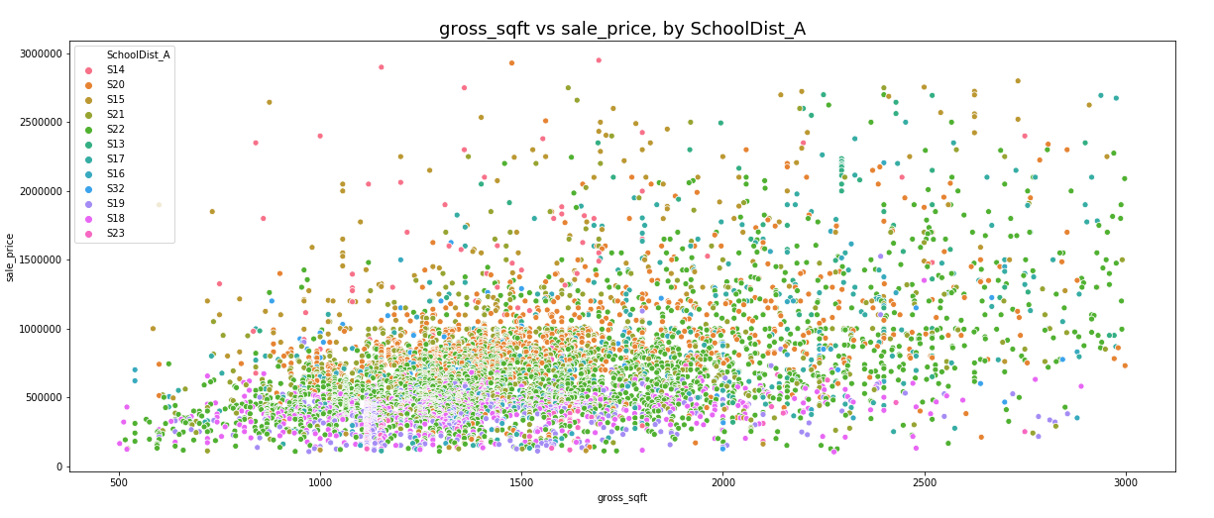
Data Exploration
The area (sq.ft) and location relationship is reaffirmed by school district influence on sale price.

Slide 8
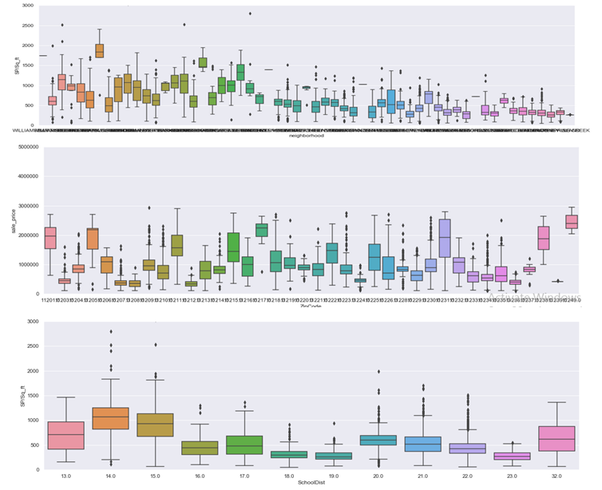
Data Exploration
….by Zipcode
Focus Variable: Location!
Along with the area (both covered square footage & lot area), the location seems to emerge as the key determinant of sales price...
Three location features are available:
Zip code
Neighbourhood
School Districts
The variables are not mutually exclusive and present significant challenges for analysis and regression purposes because of variation and interdependence...
Covariances cannot be calculated meaningfully (categorical variable)
50+ Zip Codes > 35+ Neighbourhoods > 12 school districts.
….by Neighbourhood
….by School District

Slide 9
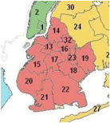
Data Analysis
Location Value Matrix
School District Ratings :
District 22 - 8 (4 &4)
District 20 - 7.5
District 21 - 6.5
District 17 - 6.5
District 15 - 5.5
District 18 - 5.5
District 19 - 5.5
District 32 - 4.5
District 13 - 3
District 14 - 2.5
(2 & 0.5)
Formula: Value = Affordability Ranking * 50% + Education Ranking * 50%
Affordability: Average Sales Price/Square Ft
Education: Great School Score
Value Criteria:
Value Matrix | First | Second | Third | Fourth | Fifth | Sixth | Seventh | Eighth | Ninth | Tenth
Education Score (50%) | 10 | 9 | 8 | 7 | 6 | 5 | 4 | 3 | 2 | 1
Affordability Score (50%) | 10 | 9 | 8 | 7 | 6 | 5 | 4 | 3 | 2 | 1

Slide 10
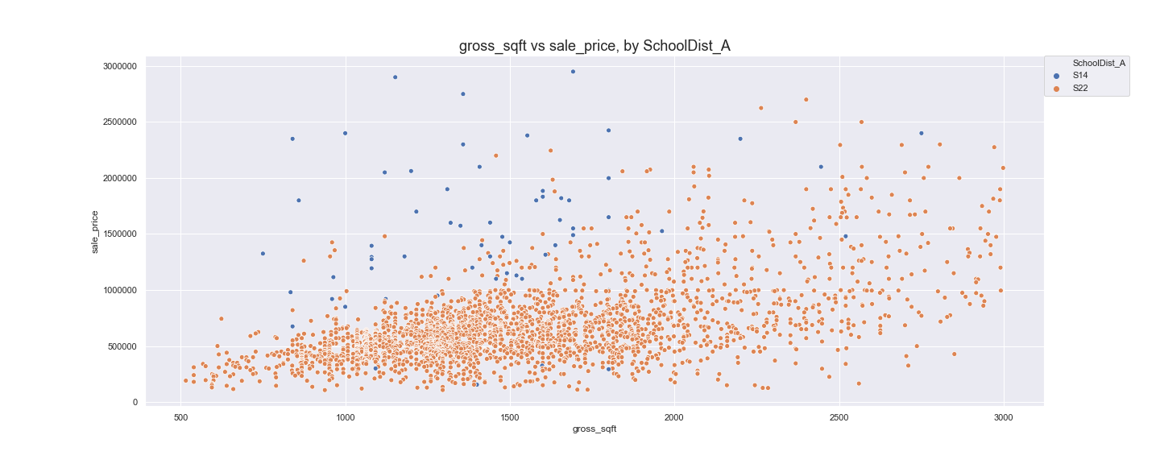
Data Analysis
Location Value Matrix
School District 22 is one of the most desirable locations for families on account of affordability and educational scores.

Slide 11
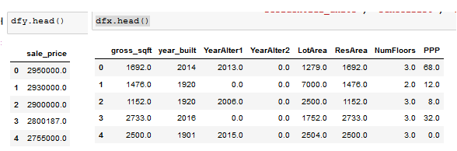
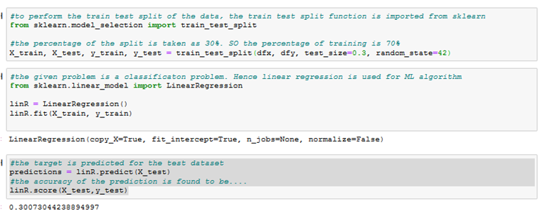
Data Analysis
Regression Modelling
Define Datasets: x(variables) & y(target)
Typical approach to regression analysis was adopted whereby:
The filtered dataset of one family homes over three latest years with 6079 observations was defined into two subsets:
Target Variable - Sales Price (y)
Independent variables (x)
The subsets were each split into:
Training Dataset (70%: 4255 observations) used to train/configure the model &
Test Dataset (30%: 1824 observations) used to test the results of the model.
Three regression models were run on datasets:
LinearRegression from sklearn.linear_model
OLS Regression from statsmodels.regression.linear_model
RMSE plot from sklearn.linear_model
Split: Training (70%), Test (30%) and RUN!

Slide 12
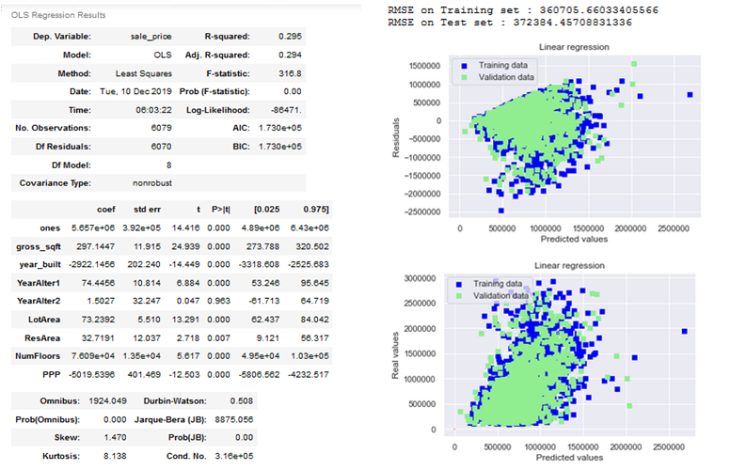
Data Analysis
Interpreting Regression Results
The models were successfully deployed and produced full array of results.
Coefficients, std errors, t-stats and P values for each variable
RMSE, Durbin-Watson, F-Stats, JB etc.
Initial runs pointed to several limitations of the analysis:
R squared low, F-stat high
Omni, DW, JB not promising
Multicollinearity...
Heteroskedasticity…
Some initial measures were explored to potentially improve results:
Normalisation
Excluding some features
Feature engineering to incorporate Location.

Slide 13
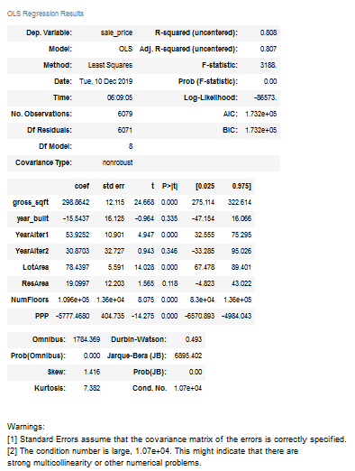
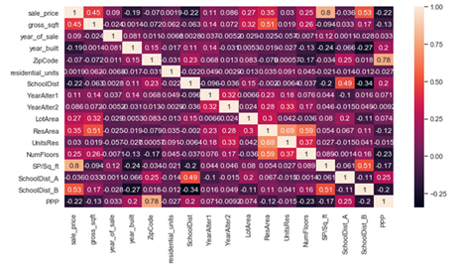
Data Analysis
Feature Engineering & Calibration
Next Steps
Given additional time results.
Detailed review of selected features to remove outliers and identify interdependencies
Feature engineering to more effectively incorporate location and other features not used or from other datasets
Explore other available libraries: Lasso, Ridge, Decision Trees etc.

Slide 14
Post Mortem
Dataset Limitations and Issues
Key Observations
School District analysis presented several challenges:
Matching School Districts to Neighborhoods proved to be time consuming, with school District Boundaries have changed over time...
The school district does not represent educational value, some rich families send their children to private schools instead...
Our team only included middle and elementary school ratings because of the high school system in New York…
Locational features within the dataset are possibly interdependent presenting challenges for regression:
School Districts, Neighborhoods and Zip Code features are essentially subsets of each other...
Possibly requires feature engineering to effectively incorporate locational variables while addressing multicollinearity and heteroskedasticity...
Large Datasets are a blessing and a curse:
With 111 features and large number of observations the data presented tremendous analytical and predictive opportunities...
The process of identifying and zoning into manageable chunks of information was time consuming and tedious...
With several interdependencies and overlaps, the right answer to many a question was usually another bigger question...
Visualizations are useful in quickly identifying trends which may otherwise take longer / be difficult to verify/validate:
Scatter plot visualization point to a clear trend in neighbourhoods closer to manhattan being more expensive..
Box plots enabled comparison of locational variables across the board allowing identification of school districts as focus variable for analysis
Interpreting and calibrating regressions/ML models to produce meaningful outputs is perhaps the real challenge :
R Squared is not the only variable to be focused on...
Understanding and keeping track how results relate to the changes in inputs requires discipline and experience

